Slide 1

Optimizing Traffic Signal Scheduling: A Game Theory Approach to Reducing Wait Times
Group Members
Syed Subhan Shah Bokhari (22P-9447)
Maaz Mustafa (22P-9405)
Moiz Ghazanfar(22P-9425)
Project Supervisor
Mr. Usama Musharaf

Slide 2
Table of content
Problem Statement
Literature Review
SUMO + TraCI
DEMO of Baseline Model
What’s Next?
Implementation Methodology
Diagrams and Figures
References
1

Slide 3

Problem Statement
“Conventional traffic signals use fixed-time cycles, which are inefficient as they cannot adapt to real-time traffic fluctuations, leading to unnecessary congestion and long delays.”
2

Slide 4
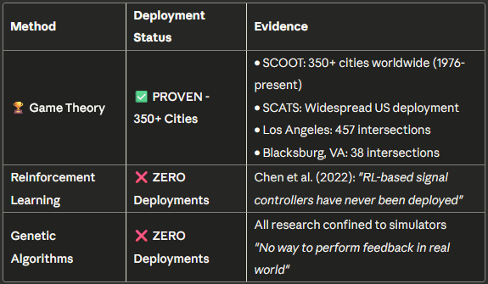
Literature Review: Performance Evaluation
3

Slide 5
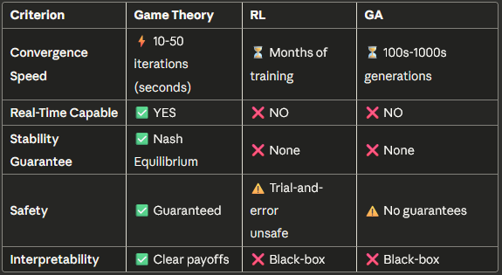
Literature Review: Performance Comparison
4

Slide 6
The ‘Black Box’ Problem
Reinforcement Learning:
“Complex and opaque neural networks hard to understand and debug" (Chen et al., 2022)
Cannot explain why a decision was made
Safety-critical systems require transparency
Genetic Algorithms:
"Survival of the fittest" is not an engineering explanation
No clear decision logic
Difficult to validate and tune
Game Theory:
Clear payoff functions: U = -(α·Wait + β·Delay + γ·Queue)
Engineers understand WHY decisions are made
Easy to validate and adjust
5

Slide 7
Timeline & Our Contribution
1970s ━━━━━ SCOOT/SCATS Development (Game Theory-based)
1976 ━━━━━ First SCOOT Deployment (Glasgow)
1980s ━━━━━ SCATS Deployment (Australia → US)
2000s ━━━━━ GA Research Begins (simulation only)
2010s ━━━━━ RL Research Surge (simulation only)
2019 ━━━━━ Zaied et al.: 457 intersections (Game Theory)
2022 ━━━━━ Chen et al. Review: "RL never deployed"
2023 ━━━━━ Wang et al.: Queue Equilibrium (Game Theory)
2025 ━━━━━ Our FYP: Game Theory in Pakistan
Our Adaptation:
Modified for multiple timeslots
Calibrated for mixed traffic
2-phase system (NS + EW)
Nash Equilibrium optimization
SUMO simulation validation
6

Slide 8
SUMO and TraCI
Dynamic Network Generation
High-Fidelity Mixed-Traffic Physics
TraCI-Based Stochastic "Chaos”
Dynamic Temporal Phases & Analytics
7
Notes:
Solved the complex issue of vehicle overlapping ("ghosting") by implementing a Sublane Model with high-precision lateral resolution (0.2m). This forces heavy vehicles to maintain strict lane discipline while allowing bikes and rickshaws to realistically weave and filter through gaps.
Utilized the TraCI interface to inject unpredictable, human-like behaviors into the agents. This includes custom algorithms for "Chaos Events" (rickshaws randomly stopping to drop passengers) and aggressive lane-changing, accurately modeling the disorder of South Asian traffic.
The simulation evolves through distinct time-of-day phases (Morning Rush, Mid-day Lull, Evening Rush) to test the network under varying loads. Real-time performance metrics (Queue Length, Wait Time, Chaos counts) are logged per direction ("Player") to CSV for data analysis.

Slide 9
Baseline Model
DEMO
8

Slide 10
What’s Next?
9

Slide 11
Implementation Methodology
INPUT:
- T_cycle: Total signal cycle time (e.g., 100 seconds)
- g_min, g_max: Minimum and maximum green time bounds
- τ_yellow, τ_all_red: Clearance times (yellow + all-red)
- α, β, γ: Weight coefficients for payoff function
- edge_ids: SUMO edge identifiers [North, East, South, West]
- ε: Convergence threshold
- η: Learning rate
- max_iterations: Maximum number of iterations
OUTPUT:
- g_NS*, g_EW*: Optimal green times for North-South and East-West phases
- performance_metrics: (avg_wait, total_delay, throughput, convergence_status)
10

Slide 12
Implementation Methodology
GAME FORMULATION:
Players: 4 approaches {North, East, South, West}
Strategy Space:
S_i = {g_i | g_min ≤ g_i ≤ g_max}
Payoff Function:
U_i(g) = -(α·W_i + β·D_i + γ·Q_residual)
Where:
W_i = Q_i × (T_cycle - g_i) // Waiting cost
D_i = Q_i² / (2 × s_i × g_i) // Delay cost (Webster's formula)
Q_residual = max(0, Q_i - s_i × g_i) // Unserved vehicles
s_i = saturation_flow × 2 // For 2 lanes per approach
Constraints:
g_NS + g_EW + 2×(τ_yellow + τ_all_red) = T_cycle
g_NS = g_North = g_South // Paired movements
g_EW = g_East = g_West // Paired movements
11

Slide 13
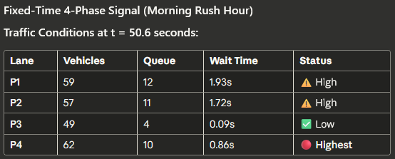
What’s Next?
12

Slide 14
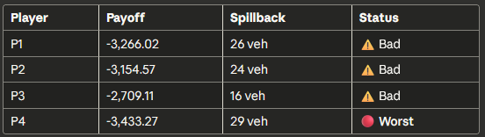
What’s Next?
13

Slide 15
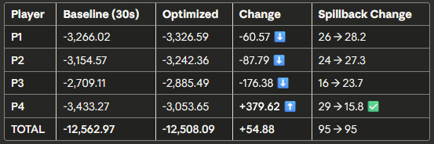
What’s Next?
14

Slide 16
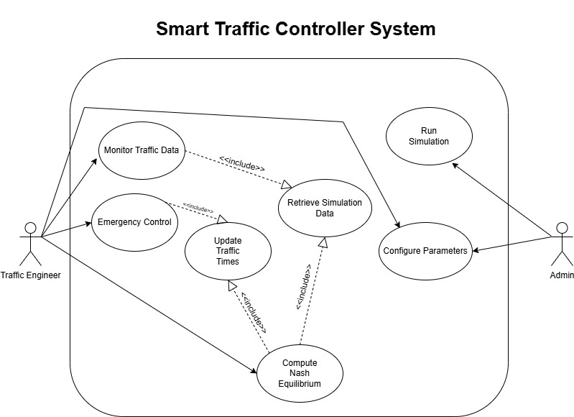
Use-Case Diagram
15

Slide 17
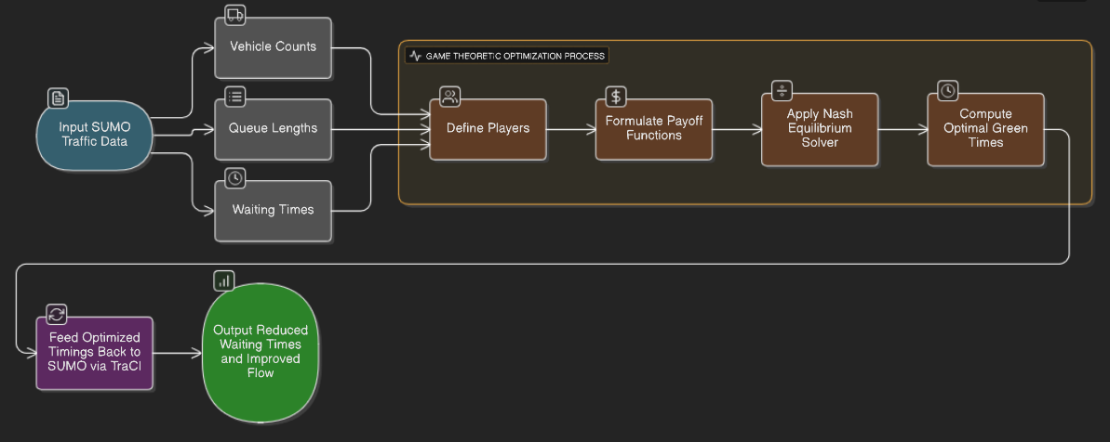
Workflow Diagram
16

Slide 18
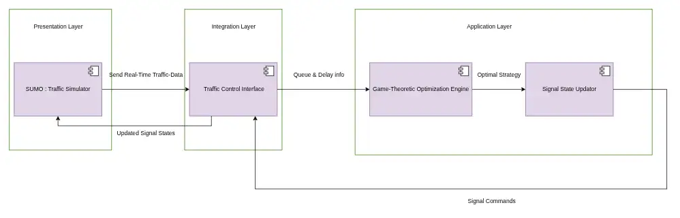
Architecture Diagram
17

Slide 19
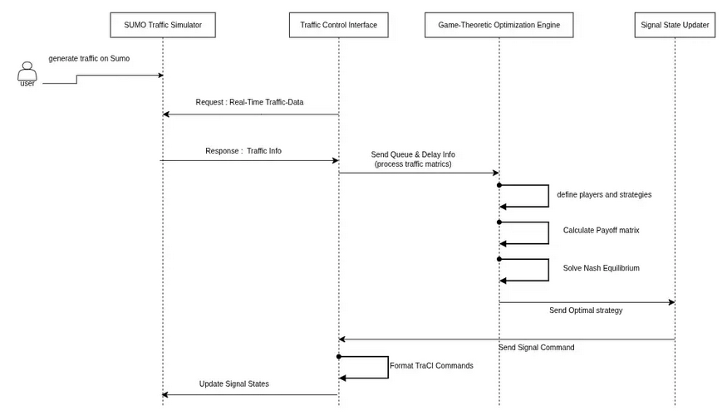
Activity Diagram
18

Slide 20
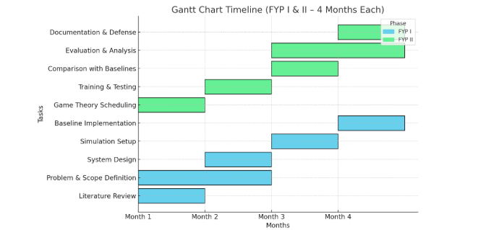
Project Planning
Fig: Gantt Chart
19

Slide 21
References
Game Theory:
Zaied et al. (2019) - Sensors - 457 intersections, Los Angeles
Wang et al. (2023) - Applied Sciences - Queue equilibrium control
Stevanovic et al. (2009) - SCOOT/SCATS deployment review
TRL Software (2024) - SCOOT: 350+ cities worldwide
Reinforcement Learning:
Chen et al. (2022) - arXiv - Comprehensive review
Key Finding: "RL-based signal controllers have never been deployed"
Identifies 4 insurmountable deployment barriers
Genetic Algorithms:
Brazilian NSGA2 Study - "No way to perform feedback in real world"
Multiple IEEE/ACM papers (2000-2020) - All simulation-based
20

Slide 22
Thank You!
21

